Slide 1
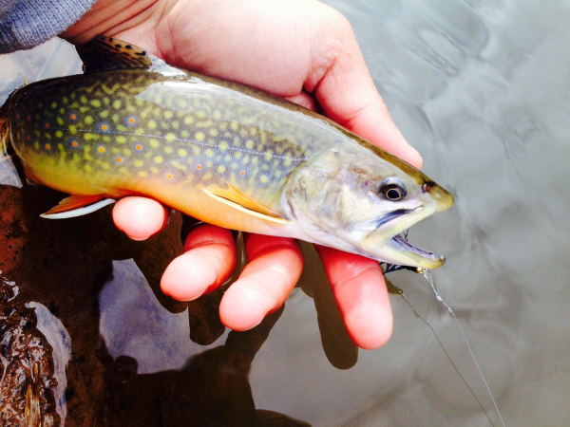
Wisconsin Brook Trout:
Facing A Changing Climate
By: Kyle Thao
Lab Section: 02

Slide 2
Wisconsin Brook Trout
Thrive in temperatures ranging from 53-75°F
Prefer fast moving, clean, and highly oxygenated waters
They are also found in Lake Michigan along the shores of Sheboygan, WI
Brook trout are native to Wisconsin unlike the European Brown Trout

Slide 3
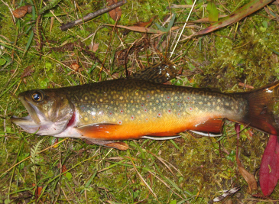
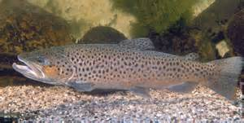
brook trout VS. Brown Trout
VS.
Brook Trout are native to Wisconsin. They have distinct yellow-orange coloration on their ventral side with a brown body. They are less tolerant of water temperatures above 72°F
Brown trout are not native to Wisconsin. They have a grey colored body speckled with black markings. They are much more tolerant than the brook trout in water temperatures above 72°F

Slide 4
The Problem At Hand:
“From 1950-2006, Wisconsin has increased by approximately 1°F” –Vimont
The slight change coincides with many other effects:
-Shorter time period for ice cover on lakes
-Shorter migration periods for birds
-longer blooming seasons for plants
-Avg. increase in temperature during winter

Slide 5
The Problem at hand
But more importantly:
By 2055, a 4-9°F increase in summer temperatures is expected to occur
This means an increase in number of days with temperatures above 90°F
Which leads to an increase in water (lake, river, stream) temperatures.

Slide 6
Why Change in water temperature matters?
Increased water temperature ultimately leads to:
-Less available oxygen in water
-Stress on brook trout
-Unsuccessful spawning (reproducing)

Slide 7
The Statistics
A 1.4°F will result in a 43.6% decrease in the brook trout population
A 4.3°F increase will result in a 94.4% decrease
A 7.2°F increase will result in a 100% decrease
These numbers are likely to be reached by the mid to late 21st century

Slide 8
The Statistics

Slide 9
What Is being Done to save the brook trout
Since 1967, fish hatcheries have been growing and releasing approximately 200,000 brook trout into Lake Michigan each year
Certain types of trout such as lake trout and brown trout are being crossed with brook trout as a form of hybridizing to make the brook trout more tolerable of warmer waters

Slide 10
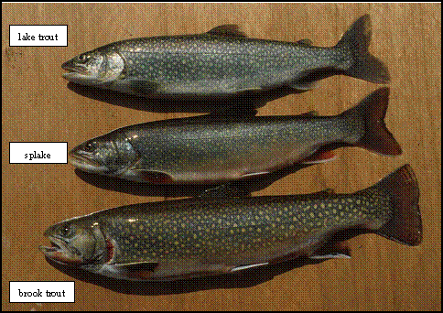
The Tiger Trout and splake
In the first picture, you see a tiger trout which is a hybrid cross of a brook trout and a brown trout, while the second picture is a cross of a brook trout and a lake trout.

Slide 11
Works cited
Dehring, Terrance, and Charles C. Krueger. "Wisconsin Department of Natural Resources." Fishing Wisconsin. Wisconsin Department Of Natural Resources, July 2008. Web. 13 Nov. 2014.
"Global Climate Change." Climate Change: Vital Signs of the Planet. N.p., n.d. Web. 13 Nov. 2014.
Magnuson, John J. "Climate Change and Trout in Wisconsin Streams." Climate Change and Trout in Wisconsin Streams (n.d.): n. pag. 25 Oct. 2009. Web.
Vimont, Daniel. "Wisconsin Initiative on Climate Change Impacts - WICCI : Climate Change." Wisconsin Initiative on Climate Change Impacts - WICCI : Climate Change. N.p., n.d. Web. 26 Nov. 2014.

Slide 12
The end

